Slide 1

Module 4: Working with Views in Siebel Answers
0/5
Analytics: Advanced Application Developer

Slide 2
Module Objectives
After completing this module you will be able to:
  Perform common tasks in views
  Create and modify different view types
Why you need to know:
  An understanding of these topics will improve your ability to create and modify Siebel Analytics views that help users look at results in meaningful, intuitive ways

Slide 3
Overview: Siebel Analytics Views
Views use Siebel Analytics presentation capabilities to help users look at results in meaningful ways
Multiple views of results help to identify trends and relationships in data
Views are available for selection on the Results tab in Siebel Answers

Slide 4
Descriptions of Siebel Analytics Views
View Name | Description
Compound Layout | Assemble different views for display on dashboards
Title | Add a title, subtitle, logo, link to help page, and timestamp
Table | Show results in a standard row and column table
Chart | Show results in a variety of chart formats
Pivot Table | Swap row, column, and section headings to obtain different perspectives
Gauge | Show results as dial, bar, and bulb style gauges
Filters | Show filters in effect for a request
Column Selector | Permit users to dynamically change which columns appear in results
Narrative | Show results as one or more paragraphs of text
Ticker | Show request results as a ticker or marquee similar to stock market tickers
Legend | Document meaning of special formatting used in results
No Results | Explanatory text if request does not return any results
Logical SQL | Show logical SQL generated for a request

Slide 5
Performing Common Tasks in Views
0/5
Duplicating Views
Previewing How Views Will Appear in Dashboards
Specifying Report Totals
Combining Values into Bins
Specifying Table View Properties

Slide 6



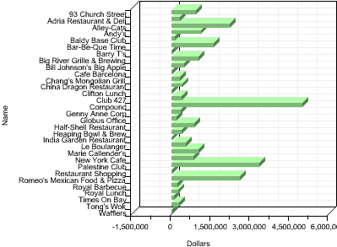
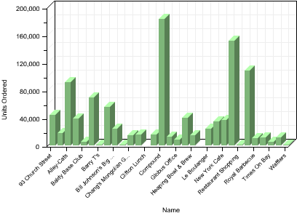
Duplicating Views
1/5
Creates a copy of the view
  Useful when you want to make changes to a view while preserving the original view, or create a new view based on an existing view
Select Duplicate View
Duplicate view has numeral 2 appended
Make changes to view
Both views can be included in compound layout

Slide 7
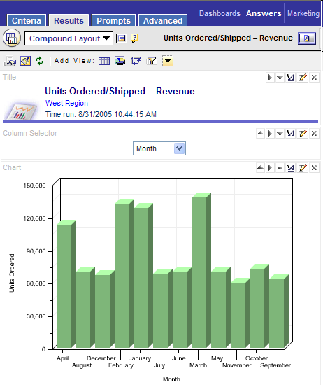
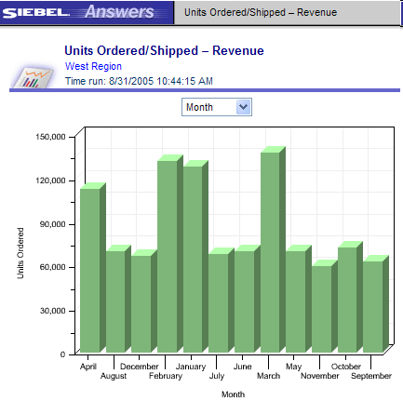
Previewing How Views Will Appear in Dashboards
2/5
Provides ability to see how a collection of views will appear in a dashboard
Click Preview button
Dashboard preview appears in a new window

Slide 8
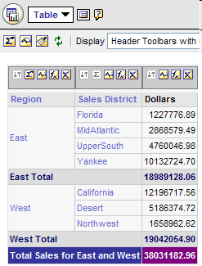
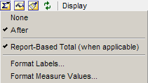
Specifying Report Totals
3/5
Specify grand totals for reports or totals for individual columns
  Report-Based Total option ensures that Siebel Analytics Server calculates total based on report with applied filters and not on entire result set
Grand Total button for report
Select total location
Grand Total button for column
Select report-based total
Format labels and values
Column total
Report total

Slide 9
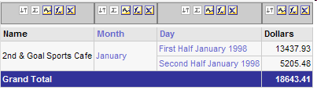
Combining Values into Bins
4/5
Use bins to combine multiple values or ranges of values from a given column
First bin combines day dollar values for first half of January 1998
Second bin combines day dollar values for second half of January 1998

Slide 10
Creating Bins
4/5
Add Bins
Name and Configure Bins
View Bin Results

Slide 11
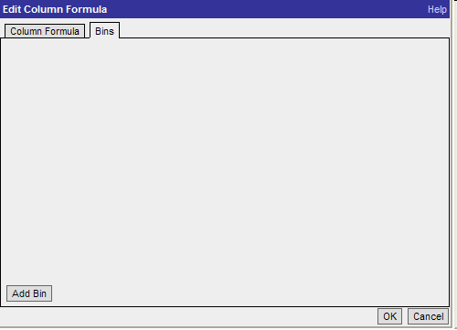
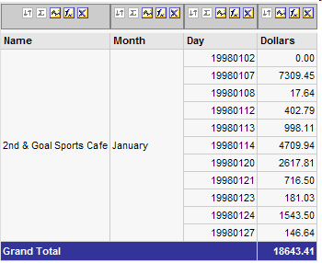
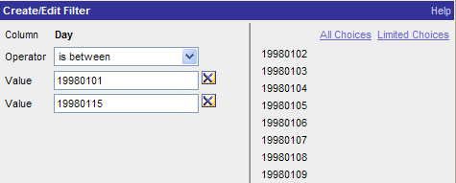
1. Add Bins
4/5
Use Bins tab in Edit Column Formula window to add bins
Click Edit Formula button
Select Bins tab
Click Add Bin
Create bin filter

Slide 12
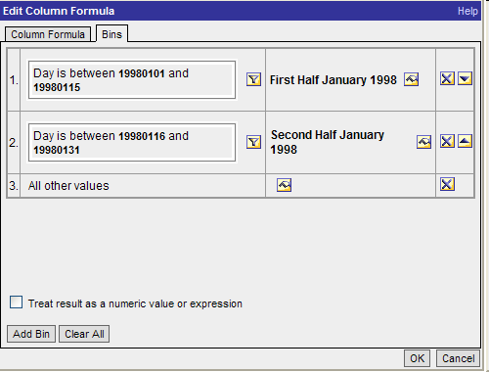
2. Name and Configure Bins
4/5
Add, edit, delete, rename, and change order of bins
Bin name
Edit bin name
Bin filter
Delete bin
Bin for all other values
Change bin order
Add more bins

Slide 13
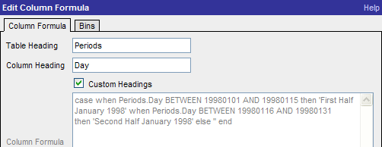
3. View Bin Results
4/5
All instances of different values that make up the bin in the result set are replaced by bin name
Navigate to column formula tab to view formula generated by bin

Slide 14
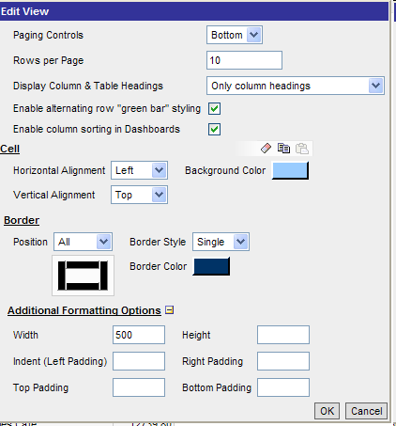

Specifying Table View Properties
5/5
Specify various options to control the look and feel of table views
Paging controls location
Rows per page
Alternate green bar styling
Click Table View Properties button
Column sorting in dashboards
Cell formatting
Border formatting
Table width, height, and padding

Slide 15
Creating and Modifying View Types
0/7
Title View
Filters View
Legend View
Narrative View
Ticker View
Logical SQL View
View Selector View

Slide 16
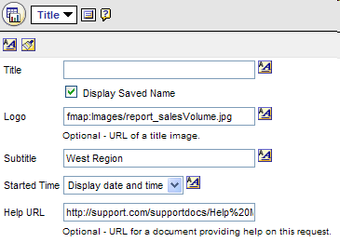

Title View
1/7
Use a title view to add a title, subtitle, logo, link to a custom online help page, and timestamps to results
Type in title or display saved request name
Click Edit buttons to modify format
Provide link to customized logo
Add subtitle
Display timestamp
Provide link to customized help

Slide 17


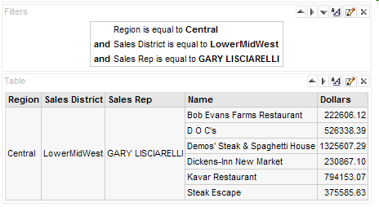
Filters View
2/7
Use a filters view to show filters in effect for a request
Create request and filter
Filters view displays filters in effect for request
Content changes with drilldown

Slide 18
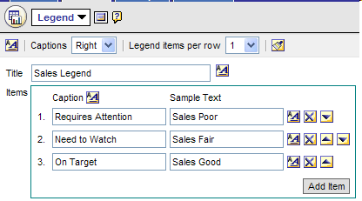
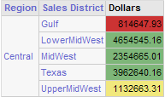
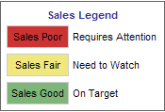
Legend View
3/7
Use a legend view to document the meaning of special formatting used in a request, such as custom colors
Captions location
Legend items per row
Legend title
Add text for items
Add captions for items
Use arrows to order items

Slide 19
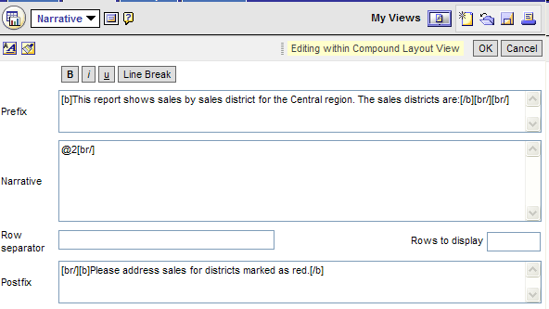
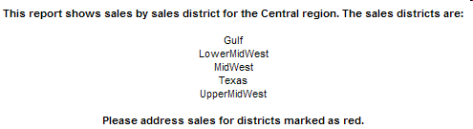
Narrative View
4/7
Use a narrative view to add one or more paragraphs of text to appear with results
Format text and add line breaks
Specify header text for narrative
Enter row separator if desired
Specify number of rows to display
Specify narrative text; use @n to include column results
Specify footer text for narrative

Slide 20
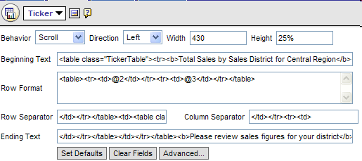

Ticker View
5/7
Use a ticker view to display results as a marquee (moving results that scroll across the page)
Set width and height in pixels or % of page
Set behavior, direction, width, and height
Use HTML to set text, formatting, and separators; use @n to include column results
Restore sample settings
Set number of loops, delay time, mouse over

Slide 21
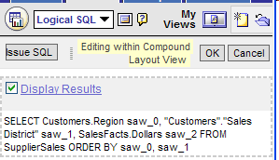
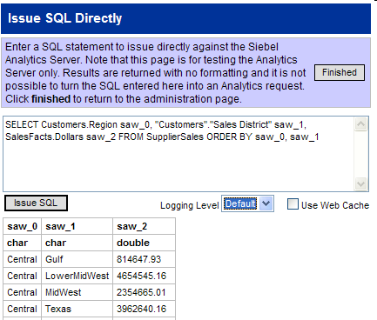
Logical SQL View
6/7
Use Logical SQL view to show SQL generated for a request
Logical SQL generated by request
Click Issue SQL to issue SQL directly against Siebel Analytics Server—for testing purposes only

Slide 22
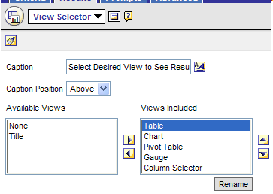
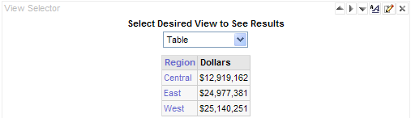
View Selector View
7/7
Use the view selector view to select a specific view of results from among saved views
  Typically, view selector views would not also be displayed in compound layout
Provide caption and caption position
Use arrows to change view position
Use arrows to include or remove views
Rename included views

Slide 23
Summary
This module showed you how to:
  Perform common tasks in views
  Create and modify different view types

Slide 24
Lab
In the lab you will:
  Perform common tasks in views
  Create and modify different view types

